Slide 1
PROMISES
Dr. Madeleine Biondolillo
Associate Commissioner, MA Dept. of Public Health
2014 Patient Safety Forum
April 7, 2014
This project was supported by grant number R18HS019508 from the Agency for Healthcare Research and Quality. The content is solely the responsibility of the authors and does not necessarily represent the official views of the Agency for Healthcare Research and Quality
Notes:
1

Slide 2
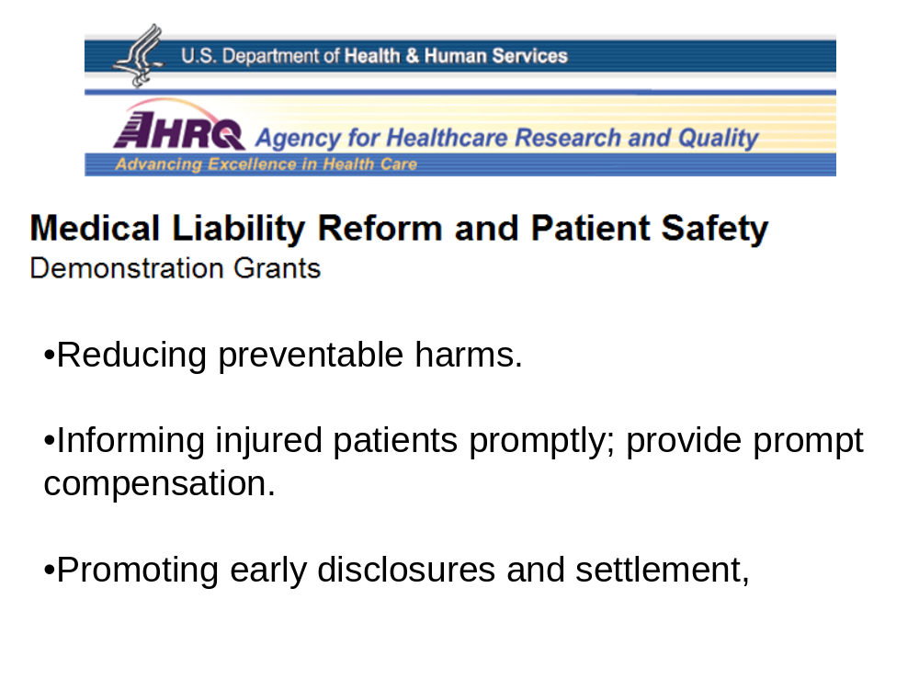

Slide 3
Coalition of Partners
AHRQ (funder)
Massachusetts Department of Public Health
Mass Coalition for the Prevention of Medical Errors
Brigham and Women’s Hospital
Institute for Healthcare Improvement
CRICO and Coverys
Massachusetts Medical Society
Healthcare For All
Harvard Schools of Medicine and Public Health

Slide 4
Can small primary care practices improve patient safety?
PROMISES tests idea that even small primary care practices,
  with few resources to support change,
  can learn the skills and techniques to improve performance in patient safety – “See problem, solve problem”
  and ultimately use that learning to support other improvement work.
3+1 = “PROMISES”
  3 key ambulatory safety process areas:
  -Test result management
  -Referral management
  -Medication management
  Plus 1 - Overarching communication issues
Notes:
PSP all settings
Worry about small primary care
White House projects – malpractice and patient safety
Partners in initiative
3 phases – talking about intervention and lessons learned

Slide 5
Successful Teams
See problems, solve problems
Test ideas regularly
Engaging a broad team, including partners outside of the practice
These strategies will work even in practices with limited resources.

Slide 6
Hearing from the practices:
“...it was incredibly helpful.”
“The PROMISES program works. Attacking it in small fundamental bites, and mapping out the process, and finding out where the actual problems are, is a process that I hope everyone learns.”
"As we did it piece by piece…, it really wasn't a lot of time, and the changes we made were so significant….“
"…when you look back now, you think, "how did we not do that 18 months ago?“
"We were able to conquer things that we did not even know existed... that is so wonderful and important in my practice, and I am so grateful for it.“
"I think the number one [benefit] was being more aware of the fact that there are areas to change, and number two was this idea of small tests of change can start small. And number three is going back and looking at the change, measuring it and testing it by asking -- did your hypothesis actually work?"
Notes:
“So before…PROMISES, it was…less organized in terms of how we handle challenges that we see in a primary care practice…we didn't have any good mechanisms in place…that whole process needed to be a lot more organized and less haphazard.”
–Practice R24 (Go Pats!)
“We were able to conquer things that we did not even know existed... Believe it or not, we had close to 40,000 or 50,000 open loops, so that we had to develop a system…it was very tedious and boring, but we…finished all of them. We are 100%. All the loops were closed... that is so wonderful and important in my practice, and I am so grateful for it.”
– Practice M34 (Full Plate)

Slide 7
Today’s Panel
Nicholas Leydon, MPH
  PROMISES Project Director, MA Department of Public Health
Peter Barker, MD
  Primary Care Physician, Doctors Practice, Swampscott
Damian Folch, MD
  Primary Care Physician, Family Practice, Chelmsford
Lorraine Kanelos
  Practice Manager, North Shore Physicians Group, Beverly
Sara Singer, MBA, PhD
  Associate Professor, Harvard School of Public Health
Gordon Schiff, MD
  Associate Director, Center for Patient Safety Research and Practice, Brigham and Women’s Hospital

Slide 8
PROMISES
Nicholas Leydon, MPH
Director and Improvement Advisor
MA Dept. of Public Health
2014 Patient Safety Forum
April 7, 2014
This project was supported by grant number R18HS019508 from the Agency for Healthcare Research and Quality. The content is solely the responsibility of the authors and does not necessarily represent the official views of the Agency for Healthcare Research and Quality
Notes:
8

Slide 9
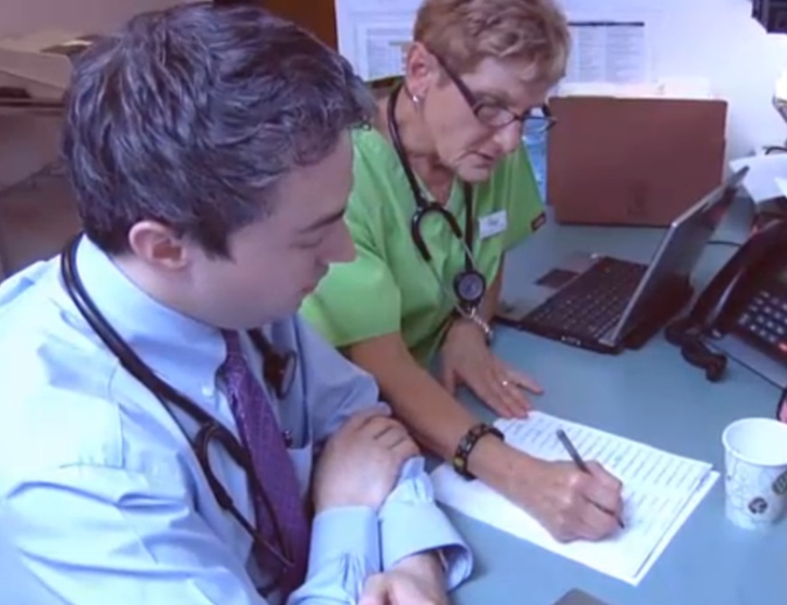
The PROMISES Approach
16 practice sites in the
intervention
Improvement:
  Monthly webinars (1hr)
  Monthly coaching meetings (90min)
  Quarterly collaborative learning
    meetings (3hr)
  2 per month Improvement Bulletins (10min)
Chart reviews, patient surveys, staff surveys

Slide 10
Working with Practices
Building a “learning system” in the organization
  See problems
  Solve problems - Analyze and Test Changes
  Leadership support for this ongoing discipline/activity
Model for Improvement
  Small tests of change
  Using PDSA cycles
  How do you know if a change was an improvement
Notes:
Elements of Organizational Learning and Improvement - * Steven Spear
Senior Lecturer, MIT Sloan School of Management
MIT Engineering Systems Division
PROMISES team
Implementing a patient safety program requires an organization to be open to constant learning, to applying that learning, and to maximizing the effective use of existing resources. Such organizations create a dynamic learning environment by*:
Incorporating the detection of problems as part of everyone’s job
Determining the underlying cause of problems; Testing small changes to identify the solution to the problem.
When something works, planning how to spread it throughout the organization, make it part of the new way things are done by showing how it developed and how it will improve their work.
Leadership ensures that all staff are actively included, motivated, encouraged and given time to participate in these activities.
This learning can be applied to any problem

Slide 11
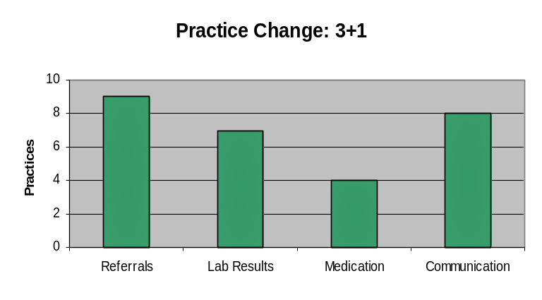
What did the practices work on?
Save time/improve efficiency
  Prescription refills
Make processes more reliable
  Test results management
  Referral follow up/management
Improve communication with patients
    Agenda setting

Slide 12
Key Learning from Intervention
Data
  Data for improvement are not common.
  Collaborative data methods challenging
Fragmented
  Wasted time chasing patients, labs, specialists.
  Reducing non-value added work would decrease waste.
Leadership
  Physician: change sponsor; enabler but not a bottleneck
  Staff: front line experts; variation
  Practice Manager: key change agent
See and Solve Problems
  Solve problems as a team
  Test ideas. Allow failure
  Discuss errors without fear
  Problems discussed as systems issue
  Embrace visits/coaching
  Steal shamelessly
Coaching
  Practices can/do improve
  Guide practice manager and team through solving process problems
  Rhythm and pace important
  Fixing problems increases joy in work
All Teach, All Learn

Slide 13

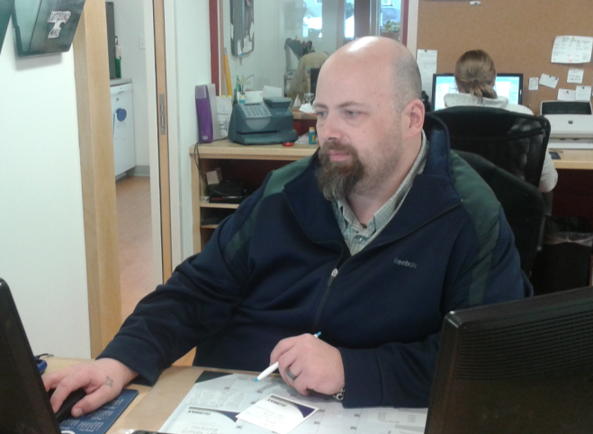
Community and Coaching
"As we did it piece by piece…, it really wasn't a lot of time, and the changes we made were so significant…."
Seeing all the practices, and having somebody ask the same question that you might have been thinking, was extremely valuable.
(Practice Manager)
When you look back now, you think, ‘how did we not do that 18 months ago?’ (Practice Manager)
Notes:
MB
The practices shared their feedback through a series of interviews after completing the PROMISES project. Many practice managers talked about the changes they had tested, and how the learning was invaluable for improving patient care and making work better at the practice.
13

Slide 14
PROMISES Curriculum
Leading a Patient Safety Program
Leadership Case Study
Improving Your Primary Care Practice #1
Improvement Case Study
Improving Your Primary Care Practice #2
Communication Case Study
Communication
Test and Referral Management Follow Up
Test Results Case Study
Referrals Case Study
Medication Management
“When Things Go Wrong in the Ambulatory Setting”
Sustaining Change
Patient Engagement
Getting Started
Communications
Improving Process
Continuous Improvement
http://www.brighamandwomens.org/PBRN/promises
Notes:
GS
On our website featured below, you’ll find a complete set of videos to guide you in your improvement journey. These tools are a useful to launch conversation or sharpen your skills in building reliable, safe care. The practices we observed benefitted most when they were routinely visited by an improvement coach and when they shared improvements with a learning network of other primary care teams.

Slide 15
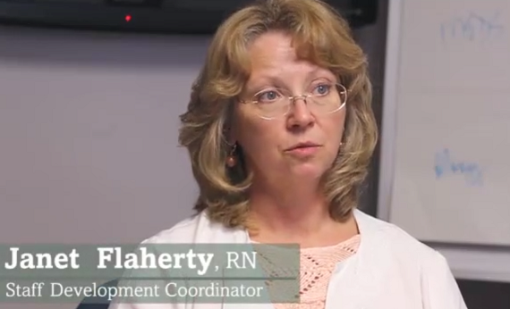
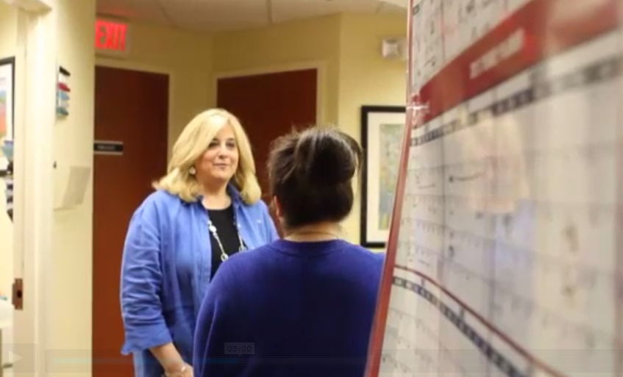
Online Patient Safety Course

Slide 16
PROMISES Practices
Peter Barker, MD
  Primary Care Physician, Doctors Practice, Swampscott
Damian Folch, MD
  Primary Care Physician, Family Practice, Chelmsford
Lorraine Kanelos
  Practice Manager, North Shore Physicians Group, Beverly

Slide 17






What making PROMISES can produce
Sara J. Singer
Harvard School of Public Health
Harvard Medical School
Mongan Institute for Health Policy, Massachusetts General Hospital
April 7, 2014
MA Coalition Patient Safety Forum
Burlington, MA
This project was supported by grant number R18HS019508 from the Agency for Healthcare Research and Quality. The content is solely the responsibility of the author and does not necessarily represent the official views of the Agency for Healthcare Research and Quality.
Notes:
17
Make it upbeat; this is a recruitment event
Objective: The objective of my presentation is to describe the results of the PROMISES program.
Sponsors
Massachusetts Coalition for the Prevention of Medical Errors
Betsy Lehman Center for Patient Safety and Medical Error Reduction
Masspro

Slide 18
Measurement and monitoring roadmap
 | Main Goals | Tools | Method | Sites | Working Groups | Timeline
Malpractice Closed Claims Database | Examine statewide closed claims data collected by malpractice insurers | CRICO/Coverys proprietary databases | Data Harmonization | Statewide - Massachusetts | Evaluation and Malpractice | Spring 2012-Spring 2013
Practice Characteristics Questionnaire | Collect info on relevant practice characteristics, culture & communication | IHI Tools | Via email | Demonstration | Evaluation and Improvement | Oct-Dec 2011
Administrator/ Staff & Providers Surveys | Pre-post comparison of practices, culture and communication | AHRQ Medical Office Safety Culture Survey; PCMH evals | Web-based | Demonstration and Control | Evaluation | Jan-Mar 2012; Jun-Aug 2013
Patient Surveys | Pre-post comparison of patient experience of care, especially as regards medications, labs, and referrals | MHQP Patient Experience Survey CG-CAHPS Adult Primary Care | Mailing (private research firm, Market Decisions) | Demonstration and Control | Evaluation | Jan-Mar 2012; Jun-Aug 2013
Site Visits: Interviews Observations | Understand work flow, strengths and weaknesses of medication, lab and referral processes; culture, communication | IHI Process Map S. Spear Tools | In-person | Demonstration | Evaluation and Improvement | Jan 2012 -Mar 2013
Chart Reviews | Pre-post comparison of medication, lab and referral error rates; understand what happens when errors occur | CRICO/Coverys Practice Evaluation Tools | On-site at practices | Demonstration | Evaluation | Apr-Jul 2012; Oct-Dec 2013
Data collected as part of improvement work and testing cycles/metrics | Qualitative and quantitative data from on the ground experience from improvement work | Logs/Diaries from IA successes, failures, lessons, surprises. PDSA cycle data | On-site at practices | Demonstration | Evaluation and Improvement | Jan 2012 -Mar 2013
Exit Interviews | Qualitative data revealing strengths and weaknesses; provide opportunities for study participant input | Semi-structured questionnaire | Via telephone | Demonstration | Evaluation | Mar-Apr 2013
Notes:
This is our measurement and monitoring roadmap.
It lays out each component of the measurement and monitoring program, the goals of the component, the tools we drew upon to develop the tools, the methods, the sites where the evaluation applied (for example, we conducted the staff and patient surveys in demonstration and control sites, but conducted the chart reviews in the demonstration sites only).
The roadmap also indicated which workgroups owned the component. Sometimes evaluation and sometimes shared between evaluation and another group (e.g., the malpractice group really helped drive the analysis of the closed claims database)
And finally the timeline for getting the work done.

Slide 19
Measurement and monitoring roadmap
 | Main Goals | Tools | Method | Sites | Working Groups | Timeline
Malpractice Closed Claims Database | Examine statewide closed claims data collected by malpractice insurers | CRICO/Coverys proprietary databases | Data Harmonization | Statewide - Massachusetts | Evaluation and Malpractice | Spring 2012-Spring 2013
Practice Characteristics Questionnaire | Collect info on relevant practice characteristics, culture & communication | IHI Tools | Via email | Demonstration | Evaluation and Improvement | Oct-Dec 2011
Administrator/ Staff & Providers Surveys | Pre-post comparison of practices, culture and communication | AHRQ Medical Office Safety Culture Survey; PCMH evals | Web-based | Demonstration and Control | Evaluation | Jan-Mar 2012; Jun-Aug 2013
Patient Surveys | Pre-post comparison of patient experience of care, especially as regards medications, labs, and referrals | MHQP Patient Experience Survey CG-CAHPS Adult Primary Care | Mailing (private research firm, Market Decisions) | Demonstration and Control | Evaluation | Jan-Mar 2012; Jun-Aug 2013
Site Visits: Interviews Observations | Understand work flow, strengths and weaknesses of medication, lab and referral processes; culture, communication | IHI Process Map S. Spear Tools | In-person | Demonstration | Evaluation and Improvement | Jan 2012 -Mar 2013
Chart Reviews | Pre-post comparison of medication, lab and referral error rates; understand what happens when errors occur | CRICO/Coverys Practice Evaluation Tools | On-site at practices | Demonstration | Evaluation | Apr-Jul 2012; Oct-Dec 2013
Data collected as part of improvement work and testing cycles/metrics | Qualitative and quantitative data from on the ground experience from improvement work | Logs/Diaries from IA successes, failures, lessons, surprises. PDSA cycle data | On-site at practices | Demonstration | Evaluation and Improvement | Jan 2012 -Mar 2013
Exit Interviews | Qualitative data revealing strengths and weaknesses; provide opportunities for study participant input | Semi-structured questionnaire | Via telephone | Demonstration | Evaluation | Mar-Apr 2013
Notes:
This is our evaluation roadmap.
It lays out each component of the evaluation, the goals of the component, the tools we drew upon to develop the tools, the methods, the sites where the evaluation applied (for example, we conducted the staff and patient surveys in demonstration and control sites, but conducted the chart reviews in the demonstration sites only).
The roadmap also indicated which workgroups owned the component. Sometimes evaluation and sometimes shared between evaluation and another group (e.g., the malpractice group really helped drive the analysis of the closed claims database)
And finally the timeline for getting the work done.

Slide 20
Staff survey results:
Test result management
Intervention practices
Control practices
5.3 pp
worse
3 pp Better
Before
After
Before
After
8.3 percentage points less negative response for intervention practices compared to controls following PROMISES

Slide 21
Staff survey results:
Teamwork
Intervention practices
Control practices
9.7 pp
worse
2.1 pp worse
Before
After
Before
After
7.6 percentage points less negative response for intervention practices compared to controls following PROMISES

Slide 22
Staff survey results:
Overall across all domains
Intervention practices
Control practices
1.1 pp
worse
0.6 pp better
Before
After
Before
After
1.8 percentage points less negative response for intervention practices compared to controls following PROMISES

Slide 23
Staff survey results:
Average medication, referral, and test results management
Intervention practices
Control practices
1.6 pp
better
3.2 pp better
Before
After
Before
After
1.6 percentage points less negative response for intervention practices compared to controls following PROMISES

Slide 24
Patient survey results:
Communication
Practices more likely to succeed
Practices less likely to succeed
0.5 pp better
1.4 pp
worse
Before
After
Before
After
1.4 percentage points less negative response for practices more likely to succeed compared to those less likely to succeed, following PROMISES

Slide 25
Patient survey results:
Coordination
Practices more likely to succeed
Practices less likely to succeed
4.5 pp
worse
1.6 pp better
Before
After
Before
After
6.0 percentage points less negative response for practices more likely to succeed compared to those less likely to succeed, following PROMISES

Slide 26
Patient survey results:
Overall across all domains
Practices more likely to succeed
Practices less likely to succeed
0.2 pp
worse
1.1 pp better
Before
After
Before
After
1.2 percentage points less negative response for practices more likely to succeed compared to those less likely to succeed, following PROMISES

Slide 27
Chart review results:
Number of potential adverse events
Intervention practices
Before
After
Potential adverse events in intervention practices declined by almost 70% after participation in the PROMISES program

Slide 28
Chart review results:
Number of serious potential adverse events
Intervention practices
Before
After
Serious potential adverse events in intervention practices declined by 57% after participation in the PROMISES program

Slide 29
Exit interview and patient survey results:
Perspectives on PROMISES
“Before…PROMISES, it was…less organized in terms of how we handle challenges that we see in a primary care practice…we didn't have any good mechanisms in place…that whole process needed to be a lot more organized and less haphazard.” –Practice R24, Go Pats!
“We were able to conquer things that we did not even know existed... Believe it or not, we had close to 40,000 or 50,000 open loops, so that we had to develop a system…it was very tedious and boring, but we…finished all of them. We are 100%. All the loops were closed... that is so wonderful and important in my practice, and I am so grateful for it.” – Practice M34, Full Plate
“Just continue improving your way in caring for your patients. Keep up the good job, good luck.” – Anonymous patient comment

Slide 30

Thank you!
Notes:
7 slides max
The objective of my presentation was to describe the results of the PROMISES program.

Slide 31
Doing Right by our Patients:
When Things Go Wrong
Patient Safety Forum April 7, 2014
PROMISES Presentation
Gordon Schiff MD
Clinical and Research Director -PROMISES Project
Brigham Center for Patient Safety Research & Practice
Harvard Medical School

Slide 32
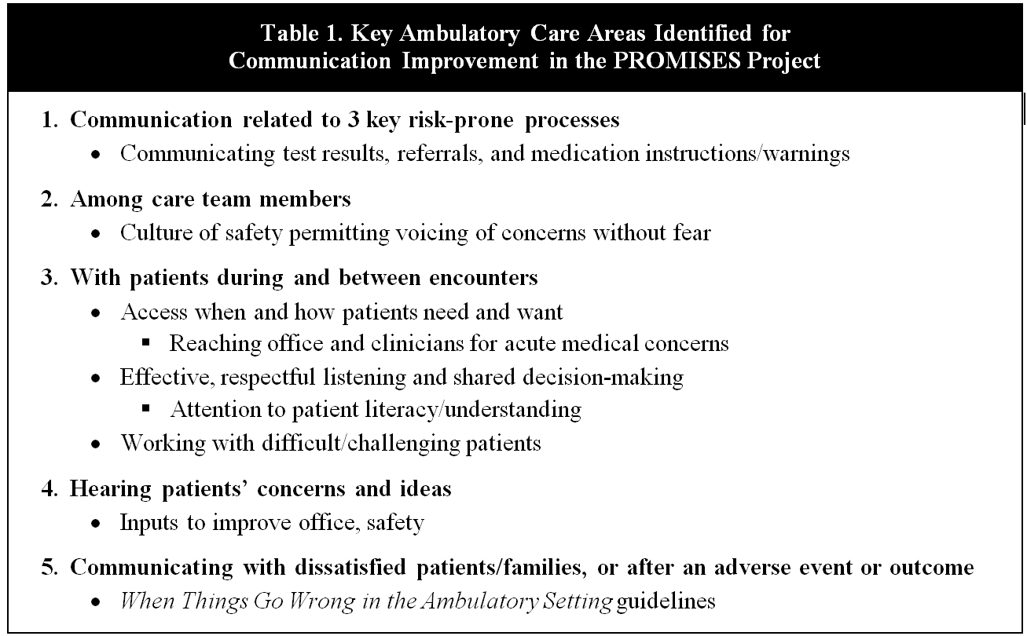
Schiff et al Jt Comm Jl Qual Safety 2014

Slide 33
PROMISES Curriculum
Leading a Patient Safety Program
Leadership Case Study
Improving Your Primary Care Practice #1
Improvement Case Study
Improving Your Primary Care Practice #2
Communication Case Study
Communication
Test and Referral Management Follow Up
Test Results Case Study
Referrals Case Study
Medication Management
“When Things Go Wrong in the Ambulatory Setting”
Sustaining Change
Patient Engagement
Getting Started
Communications
Improving Process
Continuous Improvement
http://www.brighamandwomens.org/PBRN/promises
Notes:
GS
On our website featured below, you’ll find a complete set of videos to guide you in your improvement journey. These tools are a useful to launch conversation or sharpen your skills in building reliable, safe care. The practices we observed benefitted most when they were routinely visited by an improvement coach and when they shared improvements with a learning network of other primary care teams.

Slide 34



Slide 35
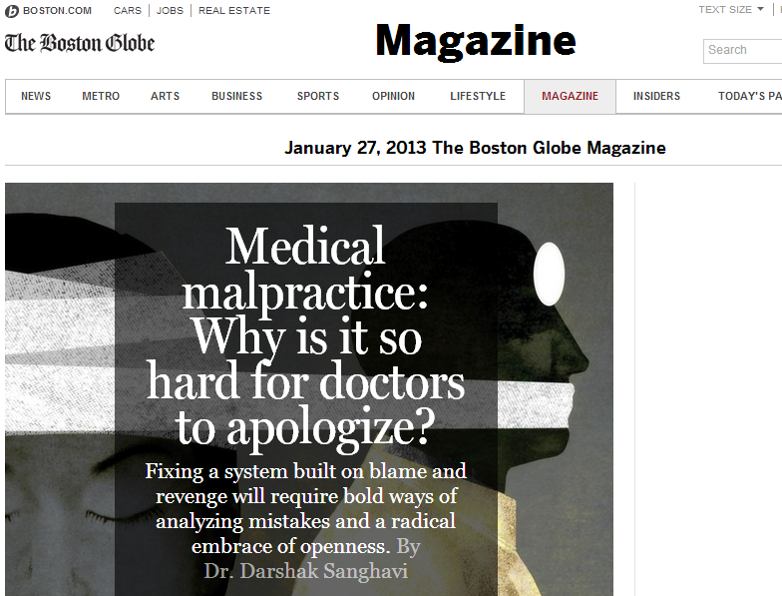

Slide 36

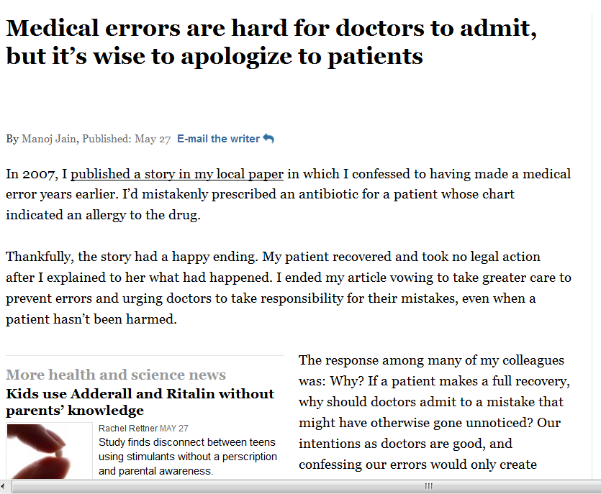
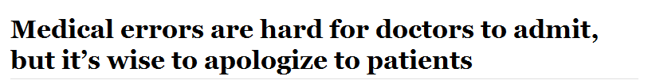

Slide 37


Slide 38
Outpatient – Why/How Different
Lack dedicated risk management offices or staff
Longitudinal provider-patient relationships
  Need to build on and maintain trust
Stressed, time-constrained, often fragmented care
Invisibility of many routine process failures, along w/ low likelihood resulting serious harm
Rarity of serious adverse events thus lack experience dealing w/ significant errors

Slide 39
Guidelines for Responding to Adverse Event
Acknowledge the event quickly. It is important to speak honestly with the patient as soon as possible when you learn something has gone wrong. Delays may allow the patient to assume you are hiding something, which can erode trust.

Slide 40
Report only the facts of the incident. Initially tell the patient what occurred, not how or why. This second step should wait for a fuller investigation into the causes of the event.

Slide 41
Express and Act with Empathy Throughout the Disclosure Process
Acknowledge the event and express your natural feeling of empathy. Listen to the patient to show that you are genuinely sorry, and want to support them in any way you can.

Slide 42
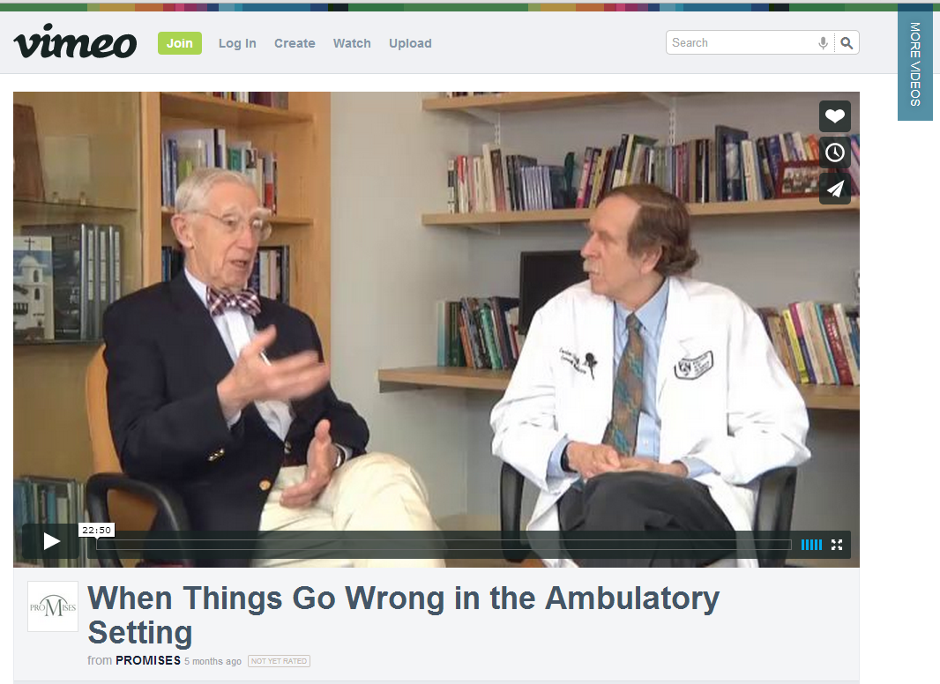
http://vimeo.com/76550944

Slide 43
Disclosure is a ongoing process and requires relationships built on trust over time

Slide 44
Follow up at regular intervals.
Call after one week, one month, and three months. Arrange a meeting when you have learned more about the causes of the event, and are able to tell them what you are doing to avoid future incidents

Slide 45
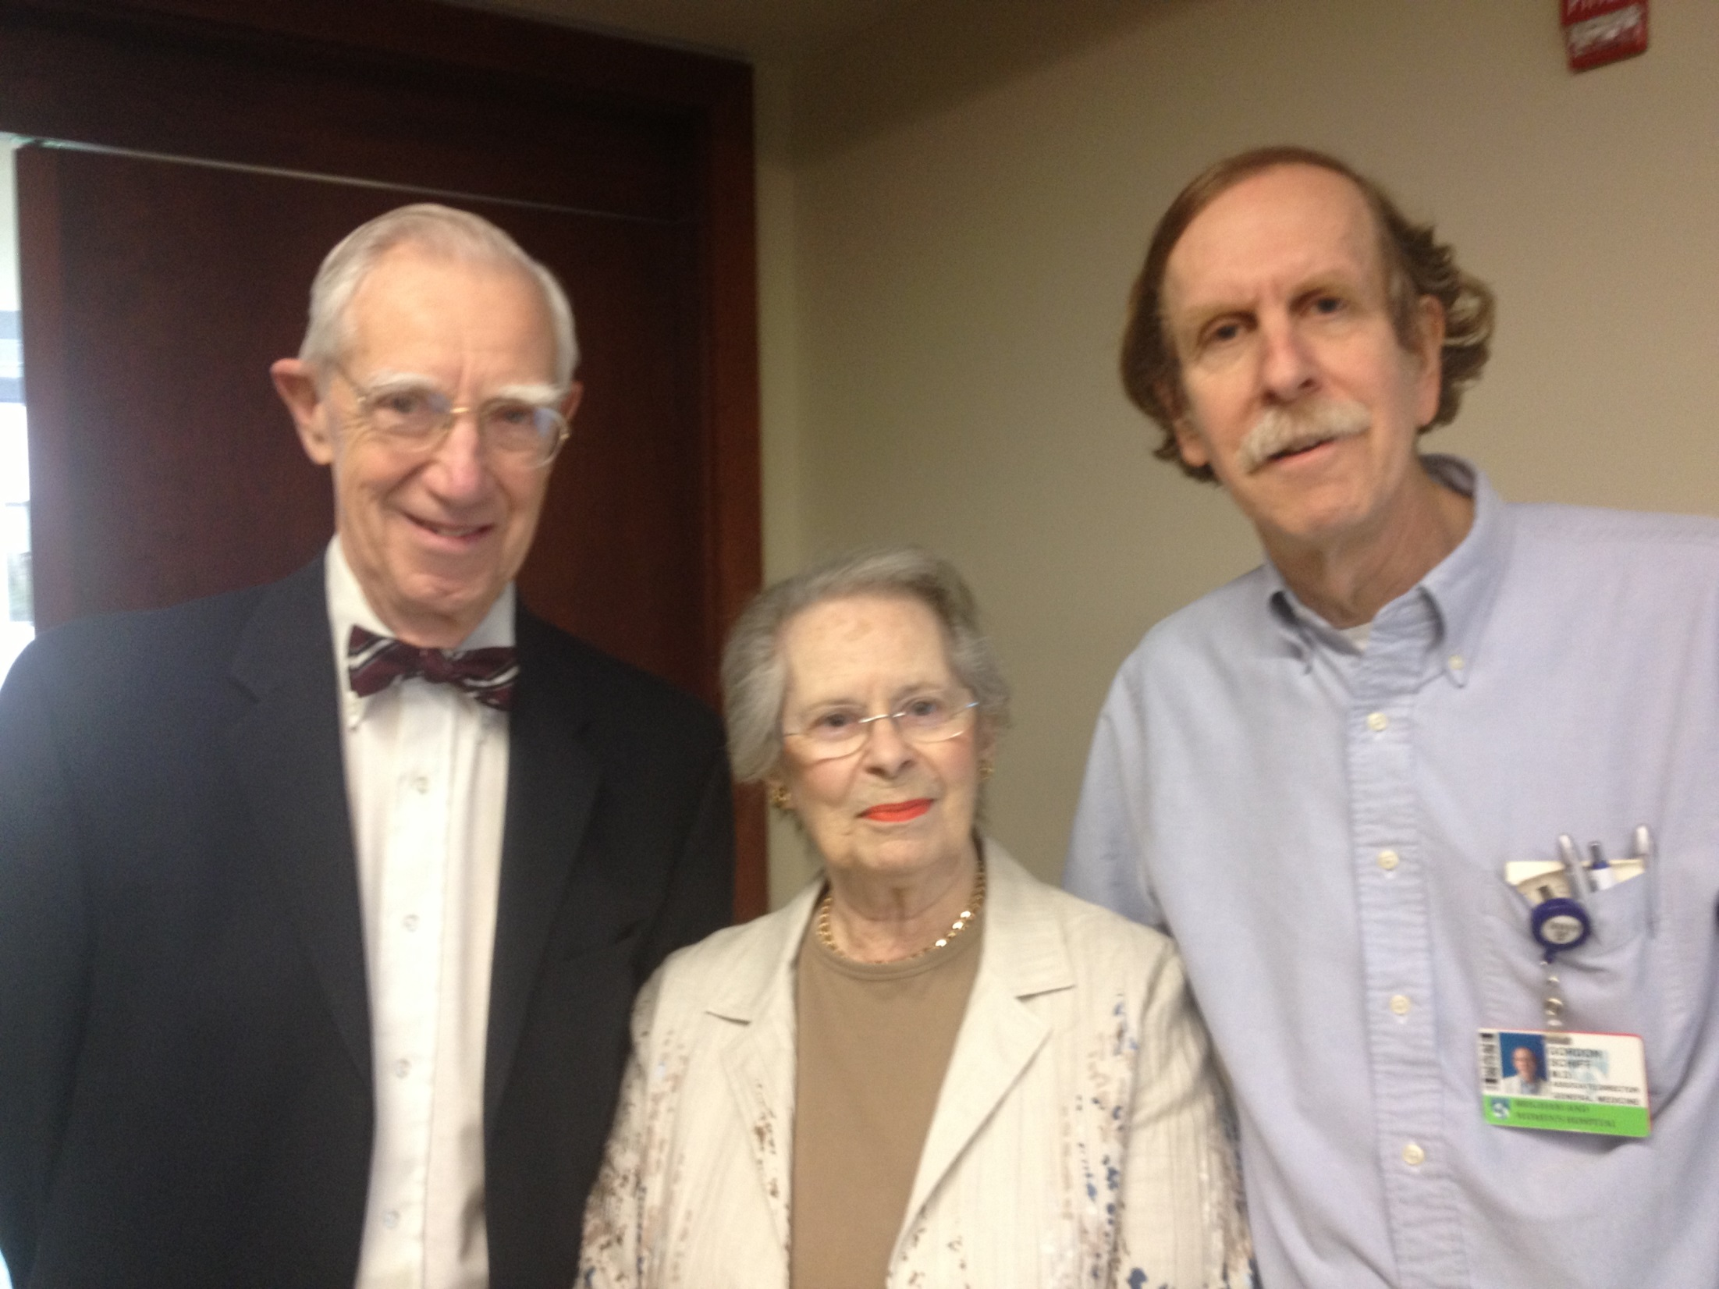

Slide 46
Current Status
Local publicity done/ongoing
  Insurers
  MA Coalition
  MA Med Society
  Brigham M&M
Joint Commission Journal
  Recent background article
National Efforts

Slide 47
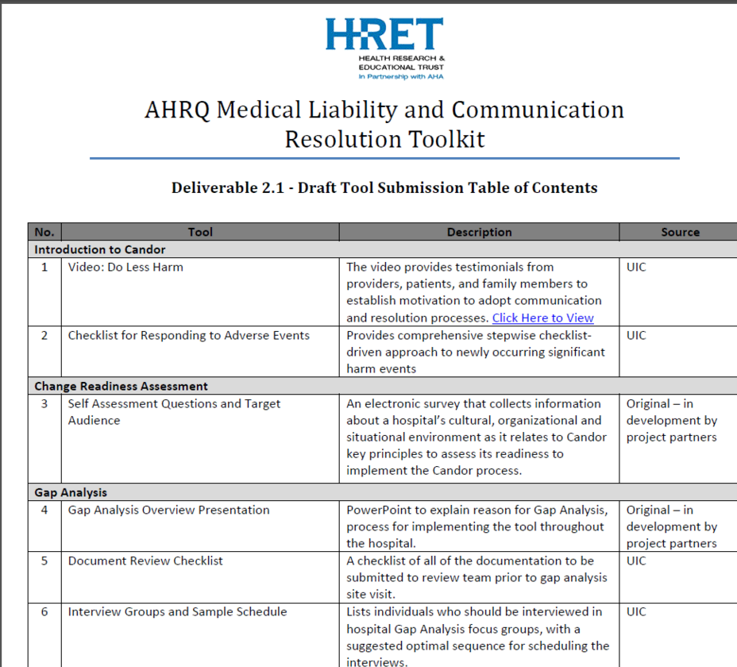

Slide 48
Q & A / Discussion

Slide 49

Thank you to our generous donors!
Blue Cross Blue Shield of Massachusetts
Nancy Ridley

